Slide 1
Welcome to
Major Work
CMSD’s Gifted & Talented Enrichment Program
Notes:
Characteristics of a Gifted Scholar

Slide 2
Our Mission Statement
The mission of the Major Work program is to challenge, enrich, and empower gifted scholars through rigorous, self-directed educational experiences in a deep and complex learning environment that drives scholars to achieve their personal best and contribute favorably to the community.

Slide 3
Our history
CMSD’s Major Work Program is the longest running gifted program in the United States
Major Work began in 1921 at Denison Elementary School
Today, Major Work services about 1,000 gifted students in grades 2-6 at 20 Cleveland schools

Slide 4
Identification vs. Service
Criteria for gifted identification is set by the ODE.
Criteria for gifted service is set by individual school districts.
Ohio law states that gifted students must be identified, but does not require gifted service.
CMSD strives to service all identified students from 2nd – 8th grade.

Slide 5
Identification process
The Ohio Department of Education sets all criteria for gifted identification
CMSD identifies students in the following areas:
Superior Cognitive Ability
Reading
Math
Creative Thinking

Slide 6
Identification Process
A test score at or above the 95th percentile is required for gifted identification
CMSD currently uses the following assessments for gifted testing:
NWEA, WISC-V, Woodcock-Johnson-IV, WPPSI, Naglieri (NNAT3), and SCALES

Slide 7
Identification process
Once identified, the test scores of gifted students become part of the school and state report card's “Gifted Indicator" until graduation
Gifted identification remains on file for the students entire academic career even if a student is exited from gifted service
Notes:
For example:
If Joey scores one time in the 95th percentile, on a 1st grade assessment, he is identified as gifted. Even if he is not serviced, his score will continue to be part of the school's indicator for the rest of his school career.

Slide 8
Identification process
Example:
If a student scores in the 95th percentile one time on a 2nd grade assessment she is identified as gifted. Even if she does not get gifted services, her score will continue to be part of the school's indicator for the rest of her school career.

Slide 9
our Focus
CMSD’s gifted curriculum follows the National Association for Gifted Children (NAGC) Standards with lessons and units that incorporate:
Higher-level Thinking
Abstract Thought
Logical Reasoning
Critical Thinking
Problem Solving
Creative Thinking

Slide 10
Major Work Program Features
Accelerated Curriculum
Depth and Complexity
Shared Inquiry
Flexible Grouping
Independent Exploration
Learning Centers
Differentiated Instruction
Problem Solving
Writing Programs

Slide 11
Gifted Assignment Waiver
Current Board Policy:
“Gifted students may be excused from assignments that were missed while attending gifted classes.”
Best Practices:
When at all possible, General Education teachers hold off on introducing new concepts and do not give tests on days when students are being pulled out of the regular classroom.

Slide 12
Acceleration
Whole Grade Acceleration
Advancing a student to a higher grade- level than is typical given the student's age
Subject Acceleration
Advancing a student in a specific subject
In both cases, an ODE approved acceleration process must be followed

Slide 13
Acceleration Process
Written Acceleration Team (WAP) is formed
Assessments are administered and reviewed
WAP team discusses results and makes a placement decision
If team decides to accelerate, a WAP is written and signed (includes short-term trial and long-term progress plan)
Student is transitioned into an accelerated placement for trial period
If trial period is successful, accelerated placement becomes permanent; student records are updated
Testing coordinator is notified of acceleration
Student takes state tests at accelerated grade level until high school graduation

Slide 14
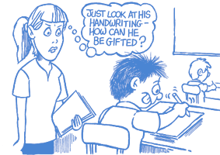
What is Giftedness?
“Giftedness” refers to students who perform or show the potential for performing (academically and/or creatively) at remarkably high levels when compared to others at their age.

Slide 15
COMMON CHARACTERISTICS
OF GIFTED LEARNERS
Highly curious
Quick learner
Comprehends nuances
Empathetic/Sensitive
Extensive vocabulary
High expectations of self
High concentration levels
High capacity of memory
Asks probing questions
Keen sense of humor
Very perceptive
Strong verbal skills
Vivid imagination
Concern for social injustice

Slide 16
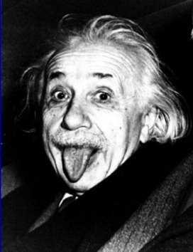
Common Myths about Gifted Learners
Gifted students don’t need much help, they can figure things out on their own
Gifted student always get high grades
Gifted students complete their assignments
Gifted students always display proper behavior

Slide 17
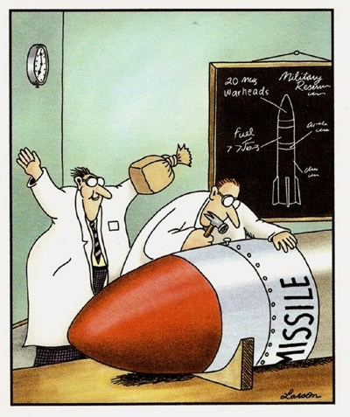
… The reality is that gifted students may become disruptive, often finding ways of amusing themselves when not sufficiently challenged.

Slide 18
Gifted students possess higher cognitive abilities . . .
. . . Yet their social, emotional, and physical development coincides with other students

Slide 19
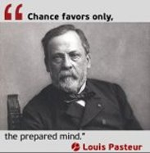
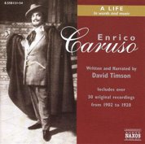
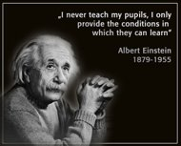
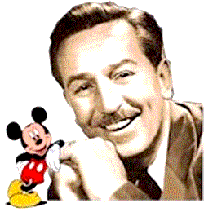
Points to Ponder
Louis Pasteur was rated as mediocre in chemistry when he attended the Royal College.​
Caruso was told by his music
teacher that he couldn't sing.
Einstein was four years old
before he could speak and seven
before he could read.
A newspaper editor fired Walt Disney for having "no good ideas."

Slide 20
SUMMARY
The ODE sets criteria for GT identification by scoring at or above the 95th percentile on norm-referenced achievement or intelligence tests.
Teachers no longer nominate students for GT identification. All test scores are reviewed each quarter by the Office of Gifted Education
ONCE identified ALWAYS identified

Slide 21
SUMMARY
Giftedness is area specific
Gifted students have special emotional and cognitive needs
Providing appropriate academic challenge for the gifted student is essential
More information can be found at
CMSD Gifted Education Homepage
Gifted and Talented Program Forms
Acceleration Policy FAQ

Slide 22
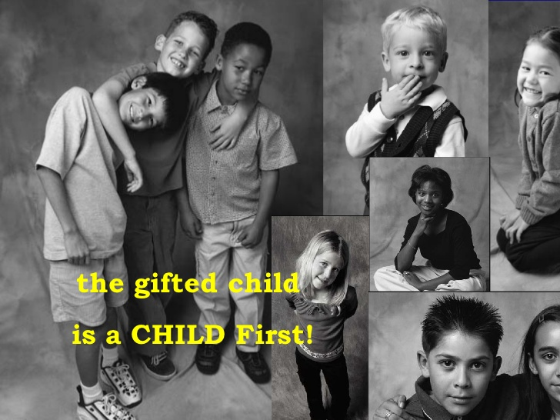
First and foremost,
always remember that

